Slide 1
Mission Critical Cloud Computing
  Francois D’Ugard
  Client / Mentor: Dr. Ming Zhao
Notes:
Hello Good Afternoon
My Name is Francois D’Ugard and my Senior Project this semester is Mission Critical Cloud Computing. My Mentor is Dr. Ming Zhao

Slide 2
Problem Statement
VMM
Host OS
Host Hardware
Notes:
Once again I would like to reintroduce you to the problem that we are addressing.
It has been shown through recent research (cite) that it is possible for a malicious user to map the structure of a public cloud and launch a malicious virtual machine to extract information from the physical infrastructure of the server via a side channel attack.
Because the attacking or malicious vm share the same cache as every other vm hosted by the server The attacking VM is able to fill the cache in a way that the target VM, which is processing a cryptographic key, may overwrite some of the attacker's data. By looking at which parts of the cache are changed, the attacking VM learns about the key in use.

Slide 3
Problem Statement: References
Ristenpart, Tromer, Shacham, Savage. Hey, You, Get Off of My Cloud: Exploring Information Leakage in Third-Party Compute Clouds –Attacks:
Osvik, Shamir, and Tromer. Cache attacks and countermeasures: the case of AES.
Page. Theoretical use of cache memory as a cryptanalytic side-channel.
Page. Defending against cache-based side-channel attacks.
Page. Partitioned cache architecture as a side-channel defense mechanism.
Percival. Cache missing for fun and profit

Slide 4
Previous Work
Spring ‘14
  Moving Target Defense System
    Migration Management
    VPN P2P Overlay Network
Summer ’14
  Multi-level Replication based Survivability of Mission-critical Cloud Computing
    True Replication Migrations
    Virtual Machines are Suspended, Migrated, and Resumed as opposed to Shutdown, Migrated, and Resumed.
    CCSW 2014: The ACM Cloud Computing Security Workshop
Notes:
In an effort to differentiate the work of previous iterations of this project and provide a clear trajectory for our project I will briefly cover the work the has been accomplished thus far.

Slide 5
Existing Network
Current Implementation of VPN P2P Overlay
Notes:
Previous iterations of this project represented the p2p overlay network as a complete digraph where every friendly virtual machine in the cloud was connected to every other friendly virtual machine.
Additionally message routing among friendly virtual machines used the shortest path resulting in maximal route lengths of 1.
In terms of efficiency this makes sense, you wouldn’t want to route messages further than you needed to.
However from a security stand point this is dangerous. It becomes trivial to differentiate mission critical commander vm’s from other vm’s. We simply observe the flow of communication among virtual machines and choose the one that receives the most messages.
So what can be done?

Slide 6
New Overlay Network
1
8
2
7
0
3
6
4
5
New Implementation of VPN P2P Overlay
Notes:
Simply put we ensure that messages are routed in a non-efficient manner among virtual machines.
We store a routing table at each virtual machine and use a routing scheme that routes messages to every other peer until it the message reaches its destination.
In this diagram the green links represent the vpn connections we intend to use. Our proposed routing scheme forwards messages between every other host in our cloud.
Furthermore we calculate the length of the path by bounding the end to end delay of any given packet by some value. This end to end delay boundary is calculated upon initialization of the system.
In doing so we hope to average the flow of packets into and out of each vm masking the commander vm.

Slide 7
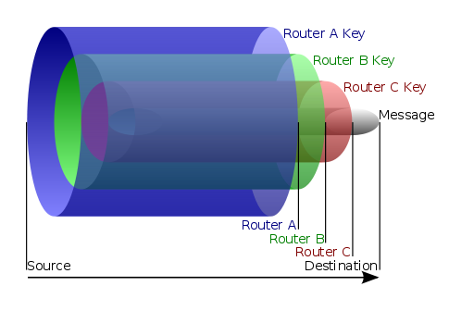
Onion Routing
​English Wikipedia user HANtwister [GFDL (http://www.gnu.org/copyleft/fdl.html) or CC-BY-SA-3.0 (http://creativecommons.org/licenses/by-sa/3.0/)], via Wikimedia Commons
Notes:
The first iteration of this project we want to implement the previous network scheme but if we want to make the network truly resilient, we should aim for a dynamic and random packet routing algorithm. So we introduce the concept of onion routing wherein the vm that originates the message, encrypts it with layers of routing information.
Doing so allows us to achieve a number of important goals
VM’s can choose a route path dynamically as well as randomly
The route length can also be randomized.
Only the originator knows the origin an destination of the packet. No node along the way has access to this information.
The paths can be changed according to evolving network size and condition.
Lastly with on demand connections vpn tunnels can be created only when we need them and then destroyed when we are done using them.

Slide 8
New Contributions
New VPN P2P Overlay
  What’s different?
    Maintain complete diagraph for resiliency
    Obscure message routing patterns of virtual machines in cloud.
    Messages are encrypted and routed to every other peer until the destination is reached.
    Routing paths can be dynamically changed autonomously or as needed via onion routing algorithms.
    We try to achieve Homogenous Network Traffic
  Implementation
    Modified IPOP VPN Controller with On demand Connections.
    Onion Routing (Future Implementation)

Slide 9
Recent Developments
Feasibility Report, Project Plan, and Requirements Documents are being updated
Primary VM is running and IPOP is installed
Creating VM image for peer VM’s with IPOP pre-installed.
IPOP Controller Development

Slide 10
Questions?

